Slide 1
KNOWLEDGE AND CURRICULUM Unit – VIII CURRICULUM EVALUATION MODELS
BY
Dr. P. JEYALAKSHMI
PRINCIPAL
SRIVATSA COLLEGE OF EDUCATION
SATTUR, VIRUDHUNAGAR.

Slide 3
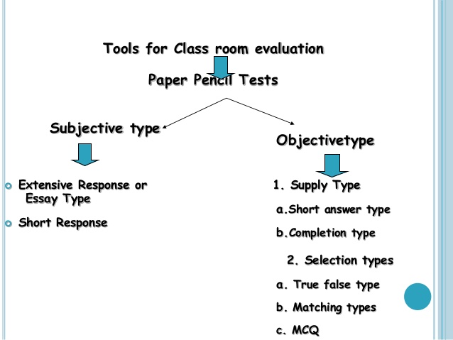

Slide 12
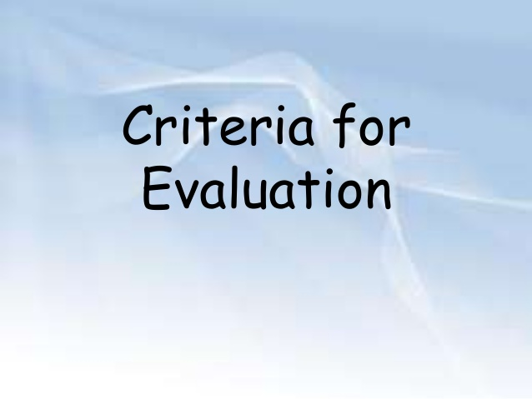

Slide 18
TYLER’S EVALUATION
MODEL

Slide 25
THANK YOU

